Slide 1
Challenges / Solutions: Fabrication

Slide 2
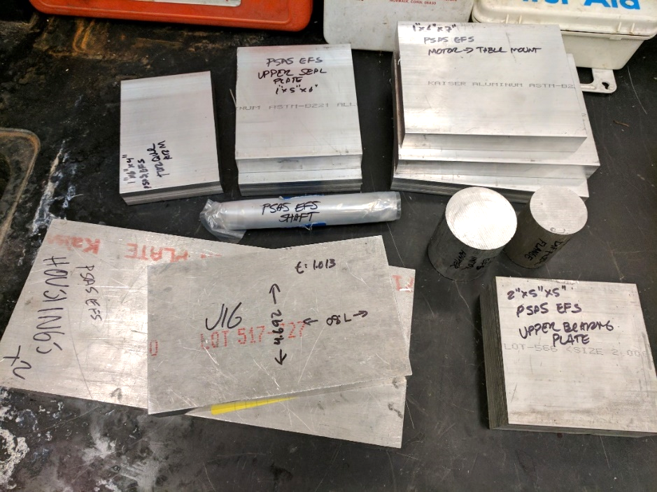
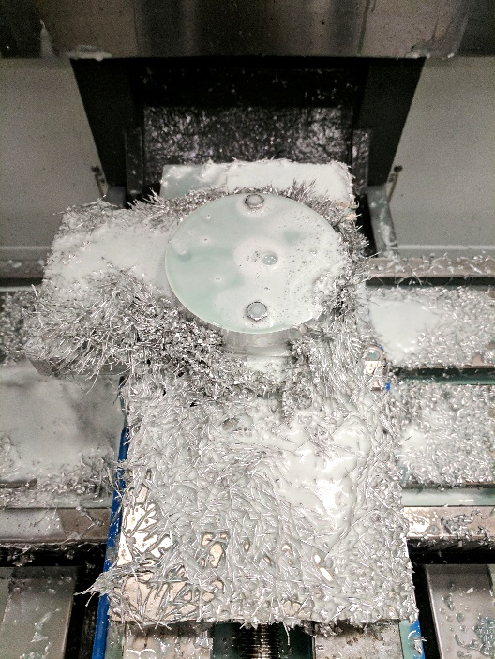
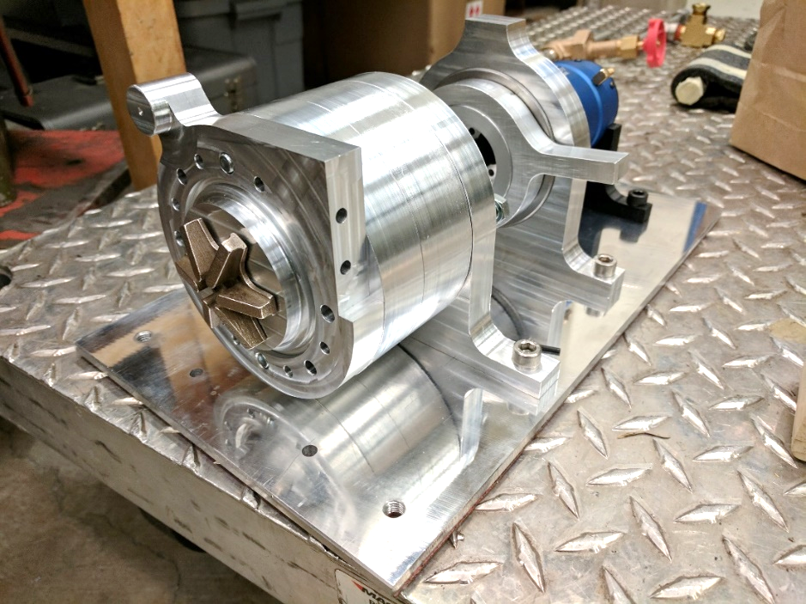
Challenge: Fabrication
Head v. flow requirements meant commercially available pumps wouldn’t work.
Outsourcing fabrication would be cost prohibitive.

Slide 3
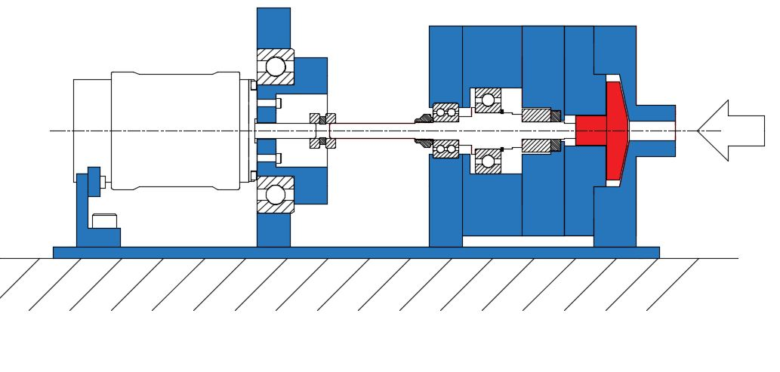
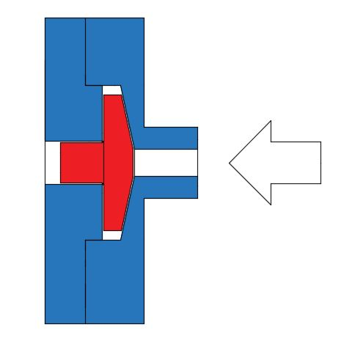
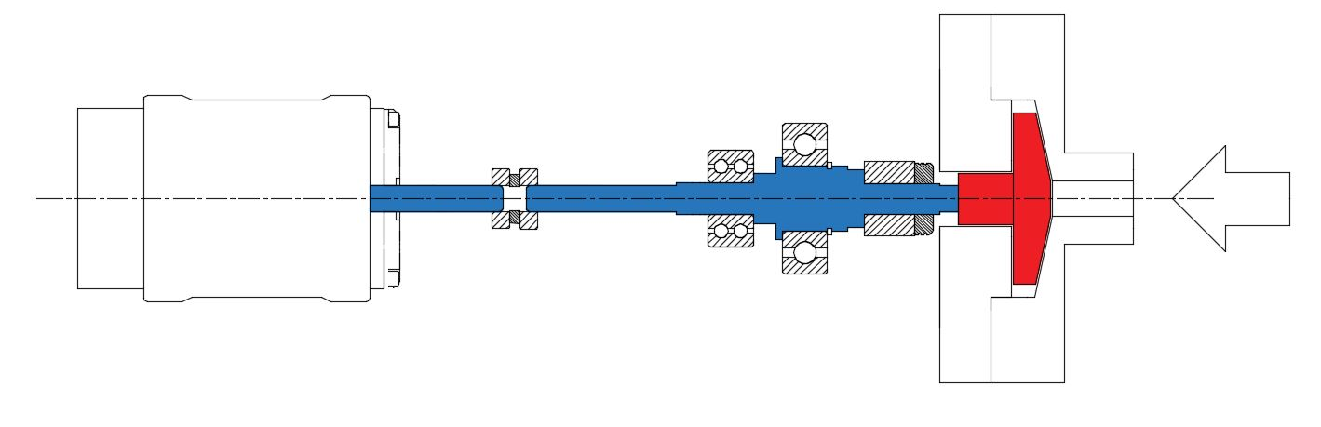
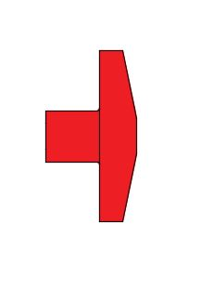
Challenge: Precision
High speeds and loads with low tolerances meant fabrication had to be precise.
+/- ~0.0007”
0.06” +/- 0.01”

Slide 4
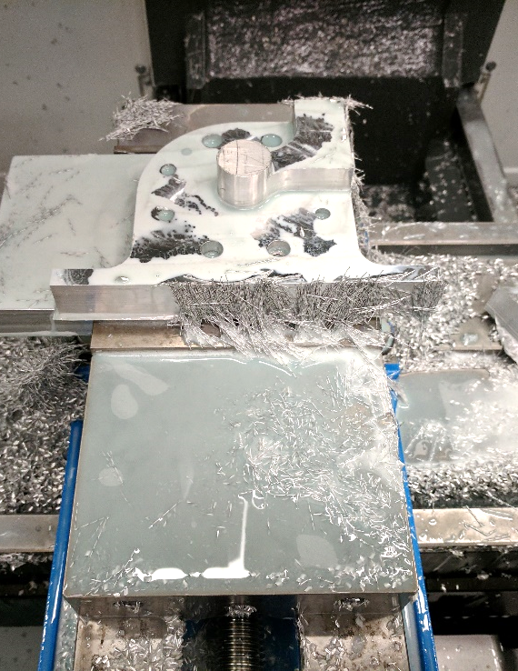
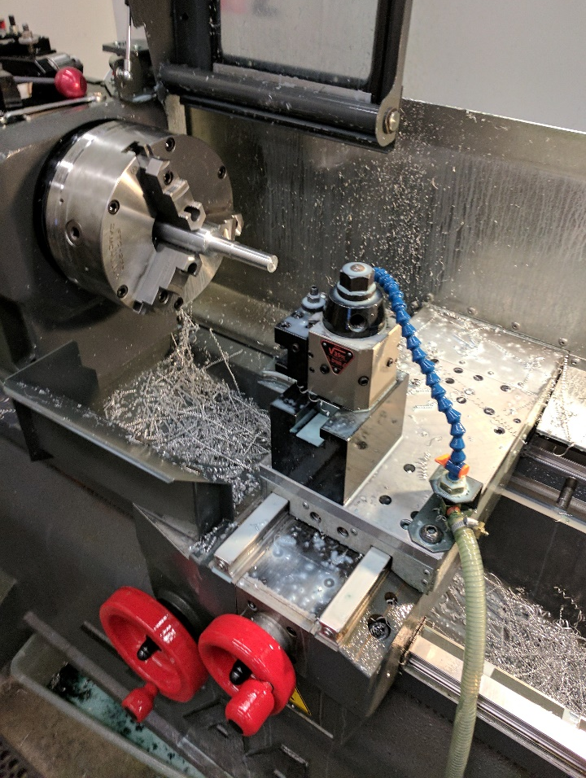
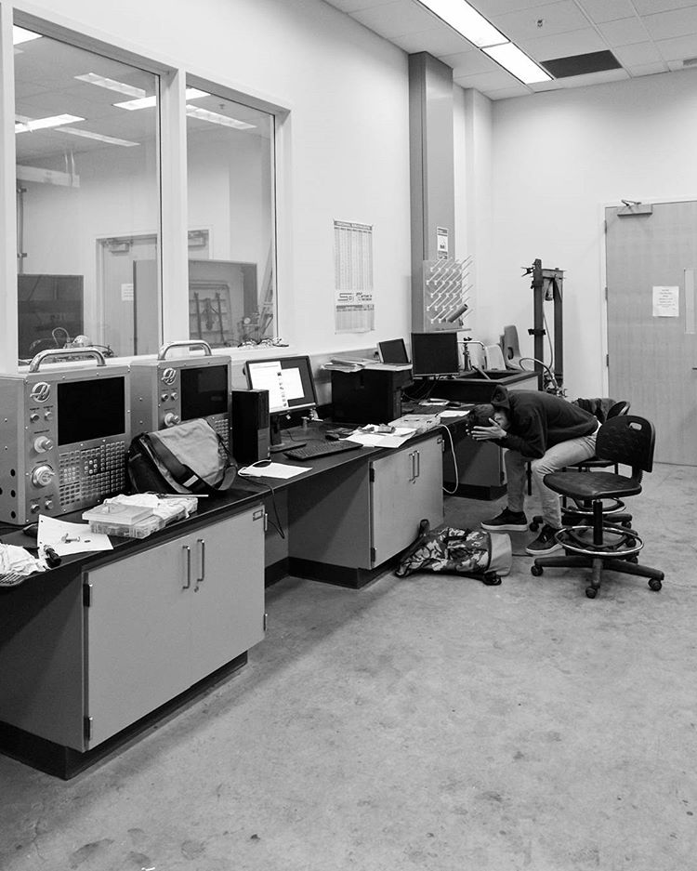
Solution: Time investment
Designed parts around available fabrication techniques.
Learned 3-axis CNC mill and 2 axis CNC lathe.
Several thousand (wo)man hours in the shop.

Slide 6
Challenges
To insert:
Photo, highlight sensors
Photo, DAQ
Photo, Motor control
Notes:
2. Controls / Measurement
Problems:
Motor control
Sensing and measurement for performance curves
Solutions:
Quad Copter rigging / controller potentiometer tricking
Sensors
Arduino DAQ
Portland State Aerospace Society | Electric Propellant Feed System

